Slide 1
Renewable Energy IPP Procurement Programme
Window two Preferred Bidders’ announcement
21 May 2012

Slide 2
Introduction
The procurement documents were released on the 03 of August 2011 and compulsory bidders conference for the first and second window on the 14 of September 2011.
The document provides for procurement of 3725MW in five different rounds subject to the availability of the MW
The Department. Under round one:
Received 53 Bids on the 4th of November
Announced 28 preferred bidders in December 2011
With regards to round two:
Received 79 bids on the 5th of March 2012
These bids amount to 3255MW whilst the cap was 1275MW

Slide 3
Procurement Process Background
Procurement documents
Request for Proposals
Part A: General Requirements and Rules
Part B: Qualification Criteria
Power Purchase Agreement
Wind PPA
Solar PPA
Implementation Agreement
Contract between the IPP and the Department
Obligation for IPP to deliver on economic development
Part C: Economic Development
CSP PPA
In buyer default – Department to pay the IPP
Small hydro
To be concluded in Phase 2

Slide 4
Contractual Arrangement
IPP
Government
Eskom
Power Purchase Agreement
Implementation Agreement
Government Framework Support Agreement

Slide 5
Procurement Process Background
RFP Part A
Requirements
Rules
RFP Part B
Qualification
RFP Part C
Comparative Evaluation
Price
Job creation
Land
Economic Develop
Finance
Technical
Environment
Price
Local content
Preferential Procurement
Enterprise Development
Socio-economic development
Capacity
Request for Proposal (RFP)

Slide 6
Part c evaluation
Price
70 %
30 %
ED
Project cost
Rand/MW
Job creation
Socio Economic
Local content

Slide 7
Overview of evaluation process

Slide 8
Evaluation Composition
Evaluation team:
Evaluation Streams:
International reviewers
Legal review – Linklaters (UK)
Technical review – Blueprint consult
Financial review – cross-moderation between the two Financial Advisory firms
Governance review – Ernst & Young
Legal evaluation team
Bowman Gilfillan
Edward Nathan Sonneberg
Ledwaba Mazwai
Webber Wentzel
BKS
Technical evaluation team
Matt Macdonald
Financial evaluation team
Ernst & Young
PWC
Legal Environment
Environmental Authorization
Legal Land
Land right
Notarial lease registration
Proof of land use application
Legal Commercial
Acceptance of the PPA
Project structure
Economic Development
Contributor status level 5
Compliance with threshold
Financial
Full and partial price indexation
Technical
Eligibility
Energy resource

Slide 9
PREFERRED BIDDERS

Slide 10
Preferred Bidders Summary
 | No of Bids | MW taken by Preferred Bidders | Maximum MW allocated for round 2
Solar photovoltaic | 9 | 417.1 | 450
Wind | 7 | 562.5 | 650
Small Hydro | 2 | 14.3 | 75
CSP | 1 | 50.00 | 50
 | TOTAL | 1 043.9

Slide 11
Preferred Bidders Solar Photovoltaic
Province | Project Name | MW
Northern Cape | Solar Capital De Aar 3 | 75.0
Northern Cape | Sishen Solar Facility | 74.0
Western Cape | Aurora | 9.0
Western Cape | Vredendal | 8.8
Northern Cape | Linde | 36.8
Eastern Cape | Dreunberg | 69.6
Northern Cape | Jasper Power Company | 75.0
Free State | Boshoff Solar Park | 60.0
Northern Cape | Upington Solar PV | 8.9
 | TOTAL | 417.1

Slide 12
Preferred Bidders Salient Terms Solar Photovoltaic
 | Bid Window 2 | Bid Window 1
Price: Fully Indexed (Ave Rand per MWh) | R 1 645 | R 2 758
MW allocation | 417 MW | 632 MW
Total Project Cost (R’million) | R12 048 | R21 937
Local Content Value (R’million) | R5 727 | R6 261
Local Content % | 47.5% | 28.5%
Job Creation : Construction (People) | 4 557 | 10 386
Job Creation : Operations (People) | 194 | 221

Slide 13
Preferred Bidders Wind
Province | Project Name | MW
Western Cape | Gouda Wind Facility | 135.2
Eastern Cape | Amakhala Emoyeni (Phase 1) Eastern Cape | 137.9
Eastern Cape | Tsitsikamma Community Wind Farm | 94.8
Western Cape | West Coast 1 | 90.8
Eastern Cape | Waainek | 23.4
Eastern Cape | Grassridge | 59.8
Eastern Cape | Chaba | 20.6
 | TOTAL | 562.5

Slide 14
Preferred Bidders Salient Terms Wind
 | Bid Window 2 | Bid Window 1
Price: Fully Indexed (Ave Rand per MWh) | R 897 | R 1 143
MW allocation | 563 MW | 634 MW
Total Project Cost (R’million) | R 10 897 | R 12 724
Local Content Value (R’million) | R 4 001 | R 2 766
Local Content % | 36.7% | 21.7%
Job Creation : Construction (People) | 1 579 | 1 869
Job Creation : Operations (People) | 65 | 128

Slide 15
Preferred Bidders Small Hydro
Province | Project Name | MW
Free State | Stortemelk Hydro (Pty) Ltd | 4.3
Northern Cape | Neusberg Hydro Electric Project A | 10.0
 | TOTAL | 14.3

Slide 16
Preferred Bidders Salient Terms Small Hydro
 | Bid Window 2 | Bid Window 1
Price: Fully Indexed (Ave Rand per MWh) | R 1 030 | N/A
MW allocation | 14 MW | N/A
Total Project Cost (R’million) | R 631 | N/A
Local Content Value (R’million) | R 421 | N/A
Local Content % | 66.7% | N/A
Job Creation : Construction (People) | 261 | N/A
Job Creation : Operations (People) | 7 | N/A

Slide 17
Preferred Bidder Concentrated Solar Power
Province | Project Name | MW
Northern Cape | Bokpoort CSP Project | 50.0
 | TOTAL | 50.0

Slide 18
Preferred Bidder Salient Terms Concentrated Solar Power
 | Bid Window 2 | Bid Window 1
Price: Fully Indexed (Ave Rand per MWh) | R 2 512 | R 2 686
MW allocation | 50 MW | 150 MW
Total Project Cost (R’million) | R 4 483 | R 11 365
Local Content Value (R’million) | R 1 638 | R 2 391
Local Content % | 36.5% | 21.0%
Job Creation : Construction (People) | 662 | 1 165
Job Creation : Operations (People) | 50 | 70

Slide 19
Preferred Bidders Job creation per Province
Description | Jobs during construction period | Jobs during operations period
 | BW2 | BW2
Eastern Cape Province | 1 026 | 64
Free State Province | 140 | 32
Limpopo Province | 0 | 0
Northern Cape Province | 4 709 | 151
North-West Province | 0 | 0
Western Cape Province | 1 184 | 81
TOTAL | 7 059 | 328

Slide 20
Preferred Bidders Investment per Province
Description | Total Project Cost (ZAR million) | Local content value (ZAR million)
Northern Cape | 12 359 | 5 837
Eastern Cape | 8 649 | 3 171
Western Cape | 4 684 | 1 829
Free State | 2 367 | 950
TOTAL | 28 059 | 11 787

Slide 21
Analysis of MW allocation and remaining MW
Technology | MW allocation in accordance with the Determination | MW capacity allocated in the First Bid Submission Phase | MW capacity allocated in the Second Bid Submission Phase | MW capacity for allocation in future Bid Submission Phases
Onshore wind | 1 850.0 MW | 634.0 MW | 562.5 MW | 653.5 MW
Solar photovoltaic | 1 450.0 MW | 631.5 MW | 417.1 MW | 401.0 MW
Concentrated solar power | 200.0 MW | 150.0 MW | 50.0 MW | 0.0 MW
Small hydro (≤ 10MW) | 75.0 MW | 0.0 MW | 14.3 MW | 60.7 MW
Landfill gas | 25.0 MW | 0.0 MW | 0.0 MW | 25.0 MW
Biomass | 12.5 MW | 0.0 MW | 0.0 MW | 12.5 MW
Biogas | 12.5 MW | 0.0 MW | 0.0 MW | 12.5 MW
Total | 3 625.0 MW | 1 415.5 MW | 1 043.9 MW | 1 165.6 MW

Slide 22
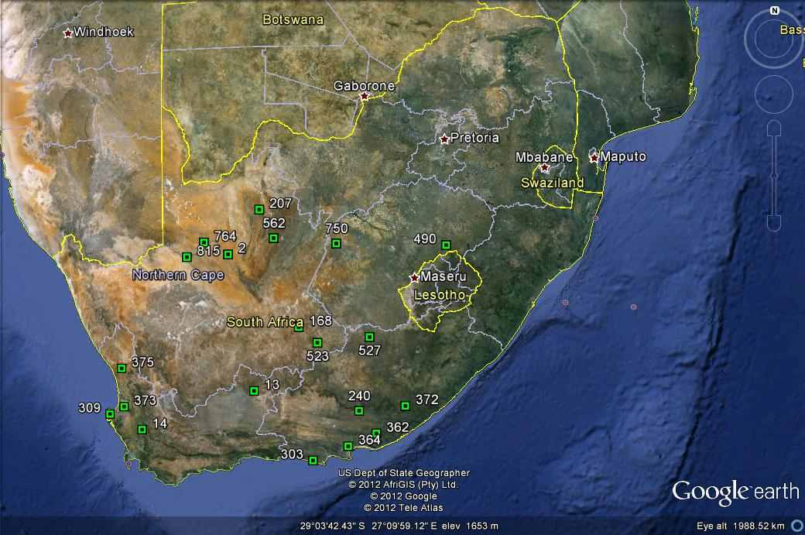
Preferred Bidders Geographic Distribution

Slide 23
THANK YOU

