Slide 1
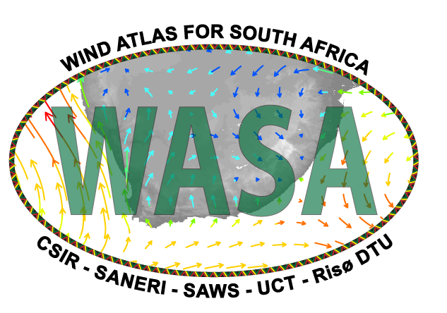
2nd Wind Seminar
28 September 2010

Slide 2
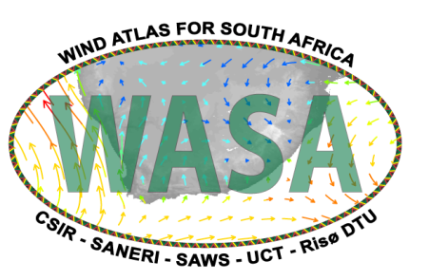
Project
The Wind Atlas for South Africa project is an initiative of the South African Government - Department of Minerals and Energy (now DoE) and the project is co-funded by
  the UNDP-GEF through the South African Wind Energy Programme (SAWEP), and
  the Royal Danish Embassy
  South African National Energy Research Institute (SANERI) is the Executing Partner coordinating and contracting contributions from the implementing partners: CSIR, UCT, SAWS, and Risø DTU.

Slide 3
Project objective
is to develop and employ numerical wind atlas methods and develop capacity to enable planning of large-scale exploitation of wind power in South Africa, including dedicated wind resource assessment and siting tools for planning purposes, i.e. the objective is the development of a numerical wind atlas and database for South Africa.
The project is phased
– Measurement program for verification for a total period of 3-years
– First wind atlas according to standard proven and tested method after 1 year of measurements
– Researched wind atlas after 3 years of measurements
All results in the public domain

Slide 4
Work Packages
WP1 – Mesoscale wind modelling
– KAMM /WRF/WAsP statistical/dynamical downscaling
– WRF – dynamical downscaling
WP2 – Wind measurements
– 10 high quality met stations 50-80m for verification
– Database of measured data
WP3 – Micro scale wind modelling
– Creation of Observational Wind Atlas for selected measurement sites in South Africa
WP4 – Application for wind resource assessment
– Mid-term Workshops for invited stakeholders from e.g. authorities, planners, developers, banks, scientists, etc.
– Develop tools - guidelines and training materials
– Micro-scale resource map for 30-50% of the modelled areas in the three provinces, incl. integration as GIS layer
– Final Workshops and training of trainers for invited stakeholders, incl. opportunities for application in
determination of extreme wind climate; seasonal forecasting; and other than wind energy.
WP5 – Extreme winds
– Application of mesoscale modelling results to the estimation of an extreme wind climate of South Africa
WP6 – Documentation and dissemination
– Prepare and disseminate research publications, incl. final book and homepage publication
– Prepare national wind seminars
– Establish and document research cooperation between South African and international wind research partners

Slide 5
Wind Measurements
Ten lattice 60m wind masts installed at sites selected primarily for their use for verification of mesoscale modelling in the project areas of Western, Northern and Eastern Cape. Data comes into the server at CSIR every 10 minutes and graphs are made available automatically for viewing online on the project web site http://www.wasa.csir.co.za.
Monthly data files are made available for download for anyone entering their registration information. Registration includes your coordinates, affiliation and the intended use. The data for each month will be ready after some QA by the project team about a week after the turn of the month from http://wasadata.csir.co.za/wasa1/WASAData.

Slide 6
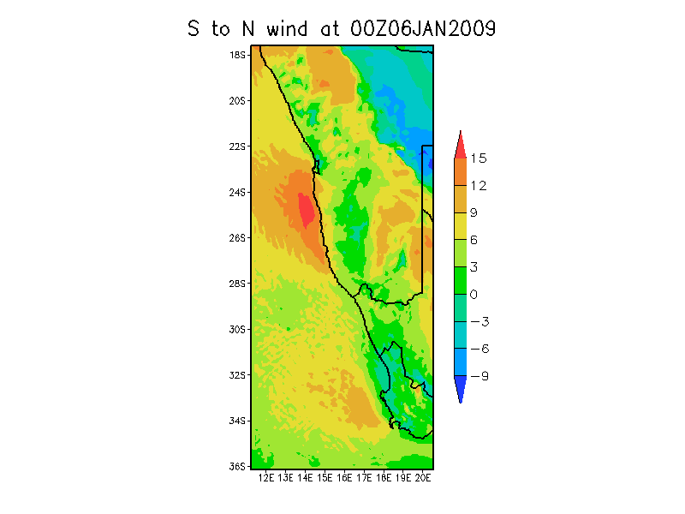
Wind Measurements

